Slide 1
UNIT 4
BASIC ACCOUNTING PRINCIPLES
BY- PROF.TANVI BAGGA

Slide 2
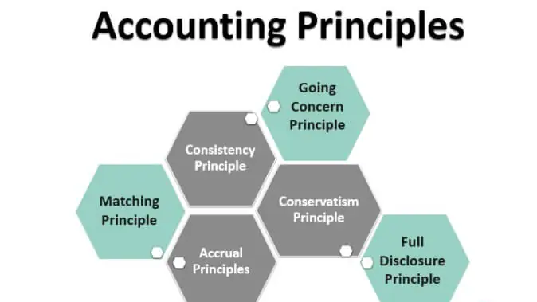
ACCOUNTING PRINCIPLES
Accounting principles are the set guidelines and rules issued by accounting standards like GAAP and IFRS for the companies to follow while recording and presenting the financial information in the books of accounts. These principles help companies present a true and fair representation of financial statements.

Slide 3
1 – Accrual principle: The company should record accounting transactions,in the same period it happens, not when the cash flow was earned. For example, let’s say that a company has sold products on credit. As per the accrual principle, the sales should be recorded during the period, not when the money would be collected.
2 – Consistency principle: If a company follows an accounting principle, it should keep following the same principle until a better one is found. If the consistency principle is not followed, the company will jump around here and there, and financial reporting will be messy. As a result, it would be difficult for investors to see where the company has been going and how it is approaching its long-term financial growth.

Slide 4
3 – Conservatism principle: As per the conservatism principle, accounting faces two alternatives – one, report a more significant amount, or two, report a lesser amount.
Let’s say that Company A has reported that it has machinery worth $60,000 as its cost. Now, as the market changes, the selling value of this machinery comes down to $50,000. Now the accountant has to choose one from two choices – first, ignore the loss the company may incur on selling the machinery before it’s sold; second, report the loss on machinery immediately.
As per the conservatism principle, the accountant should go with the former choice, i.e., to report the loss of machinery even before the loss would happen. Conservatism principle encourages the accountant to report more significant liability amount, lesser asset amount, and also a lower amount of net profits.

Slide 5
4.Seperate/single entity principle- The accounting entity concept (or entity concept or separate entity concept) is the principle that financial records are prepared for a distinct unit or entity regarded as separate from the individuals that own it.
5 – Matching principle: The matching principle is the basis of the accrual principle we have seen before. As per the matching principle, it’s said that if a company recognizes and records revenue, it should also record all costs and expenses related to it. So, for example, if a company records its sales or revenues, it should also record the cost of goods sold and also other operating expenses.
6 – Full disclosure principle: As per this principle, a company should disclose all financial information to help the readers see the company transparently. Without the full disclosure principle, the investors may misread the financial statements because they may not have all the information available to make a sound judgment.

Slide 6
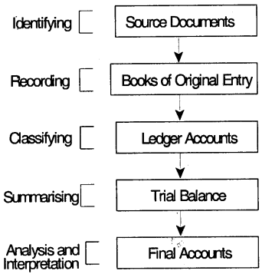
ACCOUNTING PROCEDURE/PROCESS

Slide 7
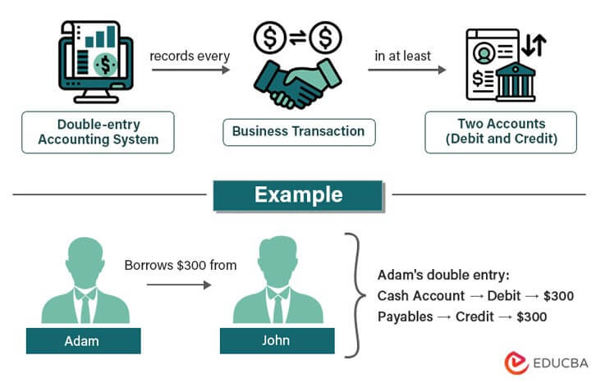
Double Entry Bookkeeping

Slide 8
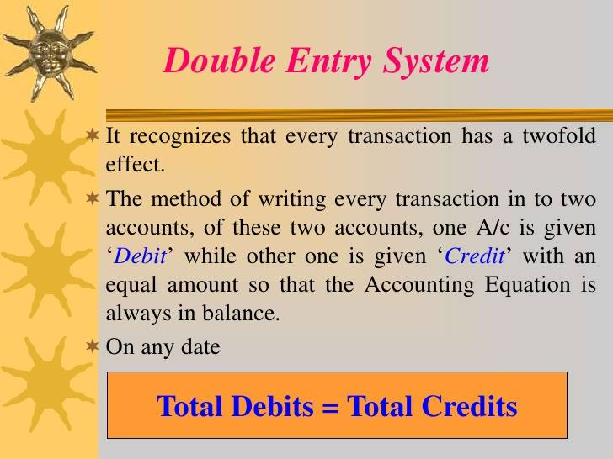

Slide 9
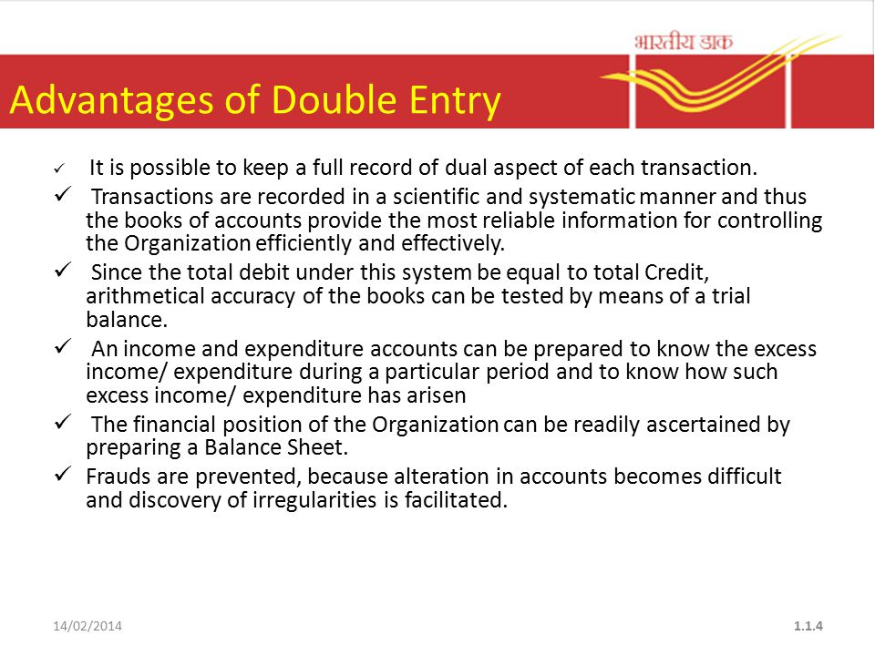

Slide 10
JOURNAL
A journal is a detailed record of all transactions done by a business.
The information recorded in a journal is used to reconcile accounts.
Entries are usually recorded using a double-entry method.
The double-entry method records a transaction in two (or more) entries. Each entry identifies the account affected, and whether the account is a credit or a debit. The totals of credits and debits must be equal.
The Journal, also called the Book of Primary Entry, is the first record of any transaction in a business. The information in these simple journal entries is then transferred to the other books of accounts.
Each journal entry contains the data significant to a single business transaction, including the date, the amount to be credited and debited, a brief description of the transaction and the accounts affected.

Slide 11
It’s crucial to accurately enter complete journal data so that the general ledger and financial reports based on this information are also accurate and complete.
Journal entries are made in chronological order and follow the double-entry accounting system, meaning each will have both a credit and a debit column.

Slide 12
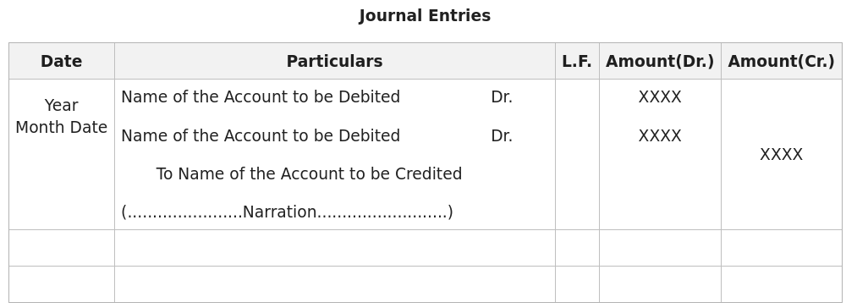

Slide 13
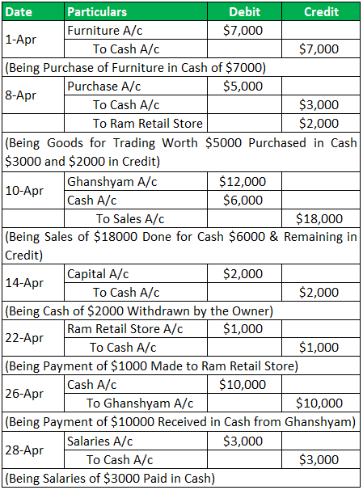
EXAMPLE OF A JOURNAL BOOK

Slide 14
LEDGER
Ledger in accounting records and processes a firm’s financial data, taken from journal entries. This becomes an important financial record for future reference. It is used for creating financial statements. It is also known as the second book of entry.
All ledger balances are transferred to the trial balance. Ledgers contain important data— income statements and balance sheets are formulated based on that information.

Slide 15
Following are some examples of ledger accounts
Accounts receivable
Cash
Depreciation
Accounts payable
Salaries and wages
Revenue
Debt
Inventory
Stockholders’ equity
Office expenses
Office expenses

Slide 16
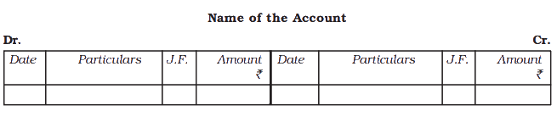
FORMAT OF A LEDGER

Slide 17
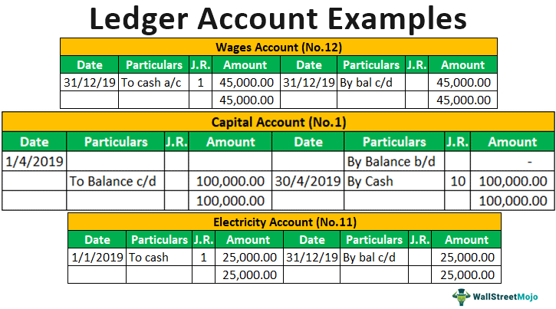

Slide 18
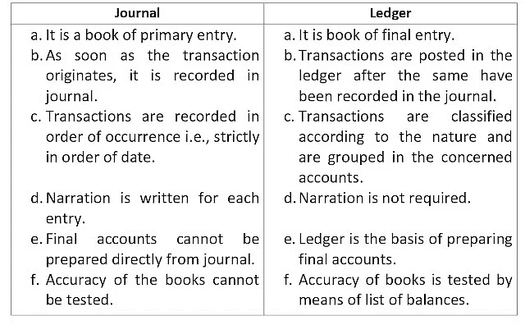

Slide 19
TRIAL BALANCE
A trial balance is a bookkeeping worksheet in which the balances of all ledgers are compiled into debit and credit account column totals that are equal. A company prepares a trial balance periodically, usually at the end of every reporting period. The general purpose of producing a trial balance is to ensure that the entries in a company’s bookkeeping system are mathematically correct.
Debits and credits of a trial balance must tally to ensure that there are no mathematical errors, but there could still be mistakes or errors in the accounting systems.
A company’s transactions are recorded in a general ledger and later summed to be included in a trial balance.

Slide 20
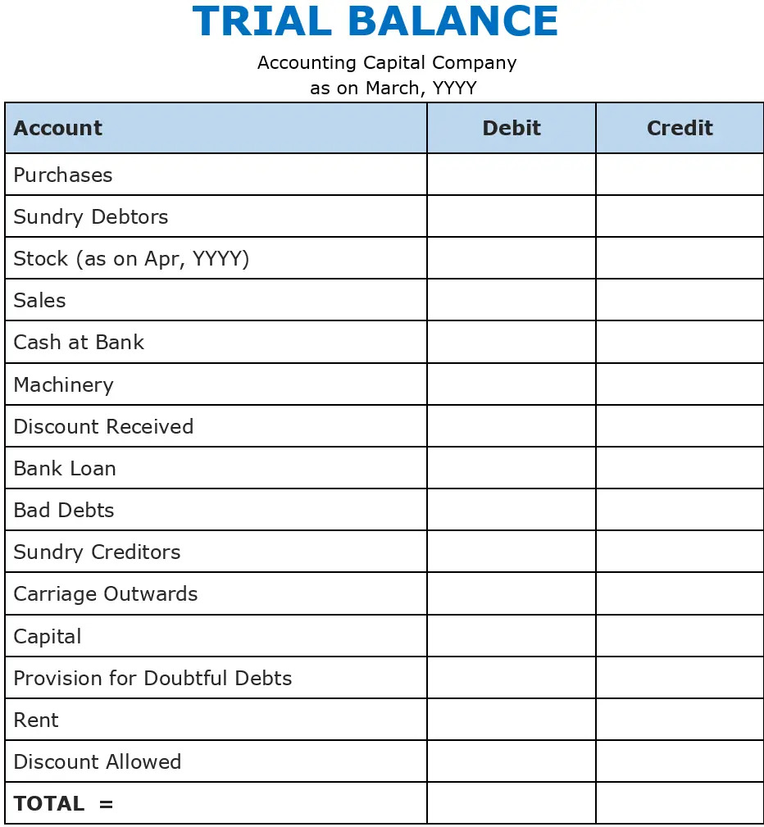
FORMAT OF A TRIAL BALANCE

Slide 21
The main objectives of a Trial Balance are as follows:
It helps in ascertaining arithmetic errors that occur while preparing accounts. Accountants can make mistakes while recording financial transactions under the double-entry bookkeeping system. When the debit and credit sides of a Trial Balance do not match, it means one of two things. One, there was an error in either recording the account balance. Or two, there is an accounting mistake made while recording the transaction in the ledgers.
It helps in preparing the financial statements of a company at the end of a financial year. The final balance of expenses and revenue accounts is taken from the Trial Balance and used in the Profit and Loss Account. Similarly, the accounts related to Assets, Liabilities and Capital gets recorded in the Balance Sheet.
A Trial Balance helps in summarising the financial transactions done while running a business. It is a consolidated summary of the financial transactions that have taken place within a financial year. It can help the management in making business decisions as well.

Slide 22
CASH BOOK
Cash book is a special type of book that is only concerned with the recording of cash transactions of an organisation. It performs the dual role of both journal and a ledger for all the cash transactions taking place in a business organisation.
.It offers easy verification of cash by matching the balance in the cash book with actual cash in hand and is therefore helpful in identifying mistakes in the entry.
.It helps in creating a regular record of transactions date wise for the convenience of accounting personnel.
. As it is maintained date wise, any cash payments or the transaction can be correctly traced back in the cash book.
. It is helpful in detecting any cash frauds in the organisation.
.It helps in saving time and labour by reducing the workload

Slide 23
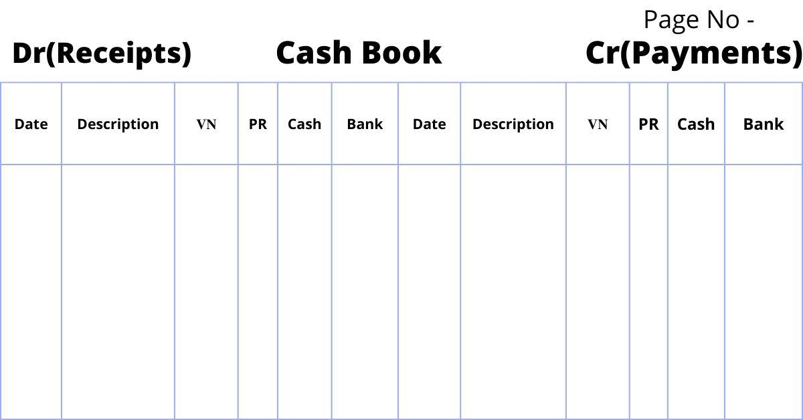
FORMAT OF A CASH BOOK

Slide 24
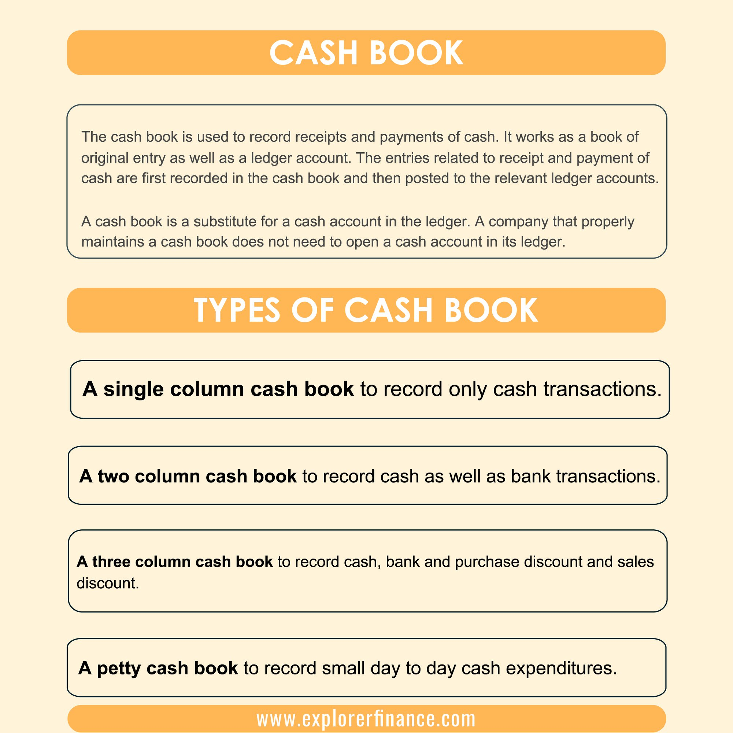

Slide 25
Trading Account
Trading account is used to determine the gross profit or gross loss of a business which results from trading activities. Trading activities are mostly related to the buying and selling activities involved in a business. Trading account is useful for businesses that are dealing in the trading business. This account helps them to easily determine the overall gross profit or gross loss of the business. The amount thus determined is an indicator of the efficiency of the business in buying and selling.
The trading account considers only the direct expenses and direct revenues while calculating gross profit. This account is mainly prepared to understand the profit earned by the business on the purchase of goods.

Slide 26
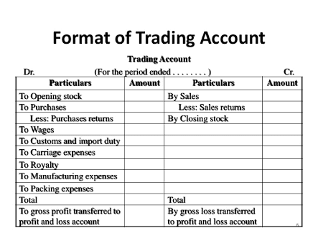
Gross profit occurs when the sales proceeds exceed the cost of goods sold. Gross profit refers to overall profit, which means operating expenses such as administrative and selling expenses are not deducted from it.
Sales proceeds less than the cost of the goods sold incur a gross loss. The balance of the trading account representing either gross profit or gross loss is transferred to the profit and loss account.
The balance of the trading account indicates the gross profit or gross loss. Credit balance represents a gross profit, while debit balance represents a gross loss.

Slide 27
PROFIT AND LOSS ACCOUNT
Profit and loss (P&L) statement refers to a financial statement that summarizes the revenues, costs, and expenses incurred during a specified period, usually a quarter or fiscal year. These records provide information about a company’s ability or inability to generate profit by increasing revenue, reducing costs, or both. Company managers and investors use P&L statements to analyze the financial health of a company.
P&L statements are also referred to as a(n):
Statement of profit and loss
Statement of operations
Statement of financial results or income
Earnings statement
Expense statement
Income statement

Slide 28
Profit and loss account shows the net profit and net loss of the business for the accounting period. This account is prepared in order to determine the net profit or net loss that occurs during an accounting period for a business concern. Net profit is the amount of money your business earns after deducting all operating, interest, and tax expenses over a given period of time. A net loss occurs when the sum total of expenses exceeds the total income or revenue generated by a business, project, transaction, or investment.

Slide 29
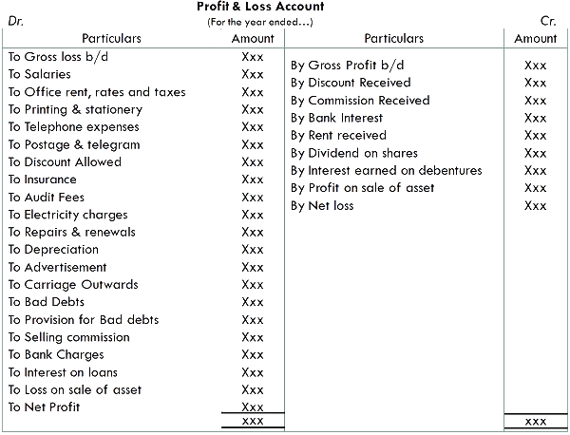

Slide 30
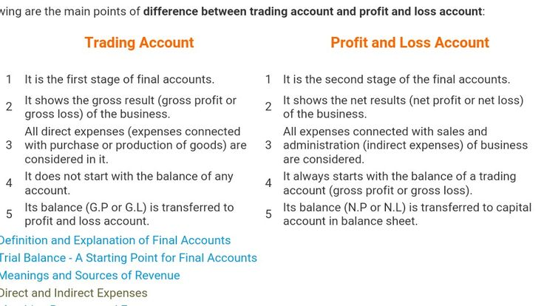

Slide 31
BALANCE SHEET
A balance sheet summarizes a company's assets, liabilities and shareholders’ equity at a specific point in time (as indicated at the top of the statement). It is one of the fundamental documents that make up a company’s financial statements.
Your balance sheet gives you a summary of your company’s financial position at a point in time and provides a clear picture of what you own and what you owe.
Balance Sheet has two main heads –assets and liabilities.
Let’s understand each one of them. What are assets? Assets are those resources or things which the company owns. They can be divided into current as well as non-current assets or long term assets.
Liabilities on are debts or obligations of a company. It is the amount that the company owes to its creditors. Liabilities can be divided into current liabilities and long term liabilities.

Slide 32
What are the main parts of a balance sheet?
1. Current assets
Cash, as well as other assets you expect to turn into cash within the next 12 months. Examples of current assets include accounts receivable and inventory.
2. Fixed assets
Property or equipment the company owns and uses in its operations to generate income. Fixed assets are purchased for long-term use (longer than one year). Their value decreases over time because of wear and tear. This change is recorded as depreciation on the income statement.
3. Current liabilities
Debts and other obligations to creditors that will be due within the next 12 months. Examples of current liabilities include accounts payable, credit card bills, sales taxes collected, payroll liabilities and loan payments.
4. Long-term liabilities
Debts and other obligations to creditors that will not be due in the next 12 months. Examples of long-term liabilities include term loans and mortgages.
5. Shareholders’ equity
This is made up of common and preferred stock, paid-in capital as well as retained earnings, meaning the accumulated company profits that have not been distributed to shareholders.

Slide 33

When looking at your balance sheet, your total assets should always equal your total liabilities plus shareholders' equity.
Let’s say you decide to buy a truck. That truck will show up as an asset on the top of your balance sheet, while the loan you took out to purchase the truck will be shown as a liability at the bottom.

Slide 34
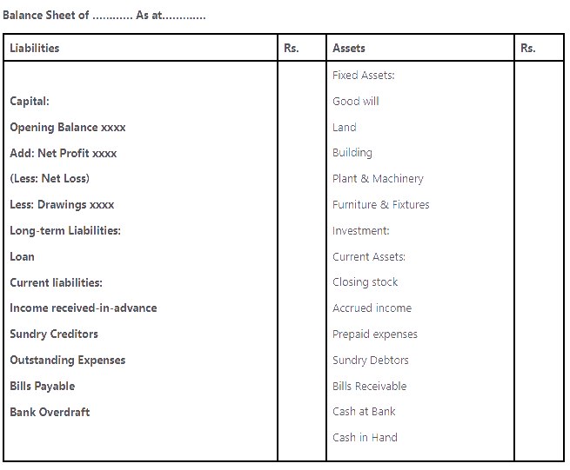
FORMAT OF A BALANCE SHEET

Slide 35
WHAT IS COST ACCOUNTING
Cost accounting is a managerial accounting process that involves recording, analyzing, and reporting a company's costs. Cost accounting is an internal process used only by a company to identify ways to reduce spending.Cost accounting is helpful because it can identify where a company is spending its money, how much it earns, and where money is being wasted or lost. Having a clear idea of the costs associated with running a business makes it easier for management to boost profitability. Cost accounting is distinct and separate from general financial accounting, which is designed for outside audiences and heavily regulated.cost accounting is commonly called a costing method, the scope of cost accounting is far broader than mere cost. Costing methods determine costs, while cost accounting is an analysis of the different types of costs a company incurs.

Slide 36
How Cost Accounting Is Used
Cost accounting can be applied to many areas of a business. Here are some examples of how it is used.
Cost Controls Cost accounting is used to help with cost controls. Firms want to be able to spend less on their inputs and charge more for their outputs. Cost accounting can be used to identify inefficiencies and apply the necessary improvements needed to control costs. These controls can include budgetary controls, standard costing, and inventory management.
Internal Costs Cost accounting can help with internal costs, such as transfer prices for companies that transfer goods and services between divisions and subsidiaries. For example, a parent company overseas might be the supplier for its U.S. subsidiary, meaning the U.S. company would be charged by the parent for any purchases of materials.
Expansion Plans Companies looking to expand their product line need to understand their cost structure. Cost accounting helps management plan for future capital expenditures, which are large plant and equipment purchases.
Preparing Financial Statements Cost accounting can contribute to preparing required financial statements, an area otherwise reserved for financial accounting. The prices and information developed and studied through cost accounting will likely make it easier to gather information for financial accounting purposes. For example, raw material costs and inventory prices are shared between both accounting methods.

Slide 37
Types of Costs in Cost Accounting
Direct Costs A direct cost is a cost directly tied to a product's production and typically includes direct materials, labor, and distribution costs. Inventory, raw materials, and employee wages for factory workers are all examples of direct costs.
Indirect Costs Indirect costs can't be directly tied to the production of a product and might include the electricity for a factory.
Variable Costs Costs that increase or decrease with production volumes tend to be classified as variable costs. A company that produces cars might have the steel involved in production as a variable cost.
Fixed Costs Fixed costs are the costs that keep a company running and don't fluctuate with sales and production volumes. A factory building or equipment lease would be classified as fixed costs.
Operating Costs Operating costs are the costs to run the day-to-day operations of the company. However, operating costs—or operating expenses—are not usually traced back to the manufactured product and can be fixed or variable.

Slide 38
COSTING
Costing refers to the process and technique of determining costs. It involves analysis of the information so as to help management identify the cost of production and selling, i.e. the total cost of various products and services, as well as to understand how the total cost is created.
Objectives of Costing
To determine the actual cost of each item, process, or operation
To identify profitable and unprofitable activities.
To act as a guide in fixing estimates and preparing quotations for the future.
To present relevant information for budgetary control.
To control costs.
To identify sources of wastes and leakages.
To determine the efficiency and productivity of labor and machines involved in the process of production.
An ideal costing system is one that is accurate, simple, equitable, elastic, comparable, prompt, and economic. It is one that fulfills all the objectives and provides periodical results to the firm. It also helps in the reconciliation with financial accounts.

Slide 39
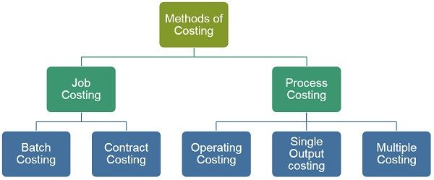
METHODS OF COSTING

Slide 40
1.Job Costing- In job costing, the cost of each job is calculated. Job costing is applicable in all the industries wherein work is carried out when a customer’s order is received such as a printing press, a motor workshop, and so forth. In this method, the job order given by the customer is unique and needs various resources for the accomplishment of the job. It is a task that is undertaken to produce a product or deliver a service that can be uniquely identifiable. In this method, the collection of costs are undertaken on the basis of each order. For Example Ship Building, Printing, Oilwell drilling, etc.
2.Batch Costing- Itis a variation of job costing, which is used in industries where similar items are produced in batches of large quantities. A batch indicates the consignment of goods produced in a factory at a time. In batch costing, each batch is treated as a cost unit, and thus cost is ascertained separately. Hence, cost per unit is ascertained by dividing the cost of the batch by the total number of units produced per batch. Further, it is suitable for industries that manufacture general-purpose machine tools, utility poles, bakery items, pharmaceuticals or drugs, toys, etc.

Slide 41
3.Contract Costing It is another version of job costing, which is associated with building and civil engineering works. Contract costing is helpful in determining the cost of each contract individually, as the costs are duly accumulated for each order. It is applicable for firms engaged in construction work of roads, buildings, flyovers, bridges, etc.
4.Process Costing In process costing, the cost of completing each stage of work is determined. This method is appropriate for manufacturing and producing entities, wherein a series of continuous as well as repetitive activities, operations are involved. It manufactures thousands of units of the same product, during a period, such as paper, soap, textiles, bread, detergent, sugar, etc.

Slide 42
5.Operating Costing Those organizations which are engaged in rendering services such as transport, water supply, retail trade, railway, bus, boiler houses, hotels, power distribution, etc use this method for ascertaining cost. Here, each service is treated as a separate unit. In this method the cost of providing or operating service is determined. Cost per unit is ascertained by dividing the total cost by the units of services provided in operating costing.
6.Single Output Costing It is applicable to the industries that produce a particular product like brick kilns, paper mills, flour mills, cement industry, steel industry. Here, the whole production cycle is costed and the cost per unit is derived by dividing total accumulated costs by the number of units produced.

Slide 43
7. Multiple Costing
Otherwise called composite costing, in this a combination of two or more methods of costing. This method is used by industries where the manufacturing process used in the production of products is complex in nature and any one method of costing cannot be used for the ascertainment of costs a combination of different costing methods is used which is called multiple costing. Industries like radio, engines, automobiles, airplanes, refrigerators, television, air conditioners, etc use this method.

Slide 44
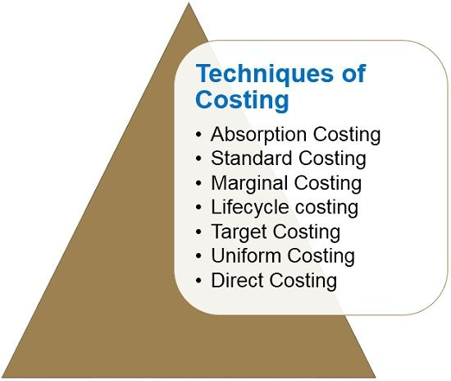
TECHNIQUES OF COSTING

Slide 45
Techniques imply the principles to be followed for ascertaining the cost of the products manufactured or services rendered.
Absorption Costing: The technique of costing in which cost is ascertained after it is incurred. In this fixed and variable costs are allocated to the units of costs and absorption of total overheads is carried out on the basis of activity level.
Standard Costing: Technique of costing in which standards are used for costs and revenues so as to control cost by way of variance analysis. Hence, it establishes standards for each cost element and for revenues and then they are compared with the actual results to determine the variances as per the originating causes. It is used in association with budgetary control. In budgetary control, budgets are prepared and continuous comparison is made between the actual result and the budgeted result.

Slide 46
Marginal Costing: A technique of costing in which all variable costs are charged to operations, processes, or products, and all fixed costs are written off against profits for the period in which they take place.
Lifecycle costing: Evaluation of total costs of production over its economic life. In order to analyze cost, the entire useful life of the product is taken into consideration, right from the stage when the product is launched to its end. Due to this very reason, it is known as cradle to grave or womb to tomb costing. Further, along with the production costs, it also takes into account pre-production costs.
Target Costing: This technique is used in a competitive environment so as to control the costs period to its designing. This facilitates the organization to operate with market-based prices. To put it simply, rather than developing a product and then making efforts for selling it to customers, in target costing, companies find out what will be sold in the market at what price and then designs the product accordingly. It indicates market-driven standards.

Slide 47
Uniform Costing: When the same costing principles are used by various firms operating in the same industry, it is known as uniform costing. It is regarded as a common system wherein common accounting principles and practices are adopted by identical firms.
Direct Costing: A practice of costing in which all direct costs are charged to operations, processes, or products, and all indirect costs are left to be written off against profits for the period in which they take place, is direct costing.

Slide 48
COST SHEET
A cost sheet is a statement that records all the costs a business incurs from production to sales.
Using this information, a company can fix the price of its products and services.
The main advantage of a cost sheet is that you can compare it with previous cost sheets to measure performance.
You can then decide whether the cost of an item can be increased or decreased according to your costs.

Slide 49
A cost sheet has to contain the following information:
Cost per unit of a product
Total cost
The four main components of a cost sheet:
Prime Cost
Works Cost
Cost of Production
Total Cost or Cost of Sales
Percentage incurred on every expense to the total cost
If the cost sheet is prepared using historical cost sheets, record of discrepancies, if any
If two cost sheets of any period are compared, record of discrepancies, if any
Details about the management for cost control
Summary of the total cost of the product

Slide 50
COMPONENTS OF COST SHEET
1.Prime Costs Under this header, you have to record all the expenses involved in the production process. This is also known as basic or first cost. For example, if you have a textile store, your prime costs will be the costs of purchasing fabric from weavers, employee salaries, packaging, implements needed to measure and cut cloth, etc. The formula for calculating prime costs is:
Prime Costs= Direct Labour + Direct Raw Material+Direct Expenses
2.Works Cost Works cost is the sum of prime costs and overhead costs including factory expenses. Overhead costs are those costs that are not directly related to the production of a product but are required nevertheless. For example, you need to pay electricity bills to keep your production going. Similarly, there are several other taxes and utility costs that fall under the overhead costs category.

Slide 51
3.Cost of Production Under this header, you should include all the expenses involved in business operations, including rents and work costs. The formula for calculating the cost of production is:
Cost of Production= (Work Costs)+(Administration Overhead Costs)-(Opening and Closing Stock of Finished Goods)
4.Cost of Sales Cost of sales or total cost contains the details of all the expenses involved in the production and other costs involved in selling and distribution. This value will help you understand how much you spend on a product according to the resources used for producing it. You can decide your selling price according to the cost of sales and know how much profit you will earn from it.

Slide 52
How to Prepare a Cost Sheet?
Step 1: Prime Cost = Direct Material Consumed + Direct Wages + Direct Expenses
Direct Material Consumed = Direct Material Purchased + OP Stock of Raw Material – CL Stock of Raw Material
Step 2: Works Cost = Prime Cost + Factory Overheads + OP Stock Work in Progress – CL Stock Work in Progress
Step 3:Cost of Production = Works Cost + Office and Administration Overhead + OP Stock of Finished Goods – CL Stock Finished Goods
Step 4: Total Cost = Cost of Production + Selling and Distribution Overheads
Profit: Sales – Total Cost

Slide 53
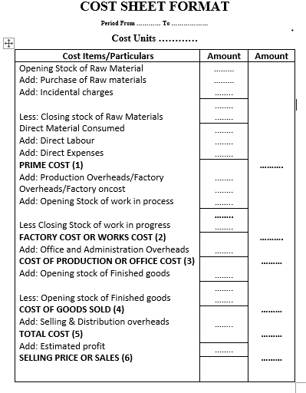

Slide 54
BREAK-EVEN ANALYSIS
A break-even analysis is an economic tool that is used to determine the cost structure of a company or the number of units that need to be sold to cover the cost. Break-even is a circumstance where a company neither makes a profit nor loss but recovers all the money spent.
The break-even analysis is used to examine the relation between the fixed cost, variable cost, and revenue. Usually, an organisation with a low fixed cost will have a low break-even point of sale.
Break-even point = Fixed cost/Price per cost – Variable cost

Slide 55
Importance of Break-Even Analysis
Manages the size of units to be sold: With the help of break-even analysis, the company or the owner comes to know how many units need to be sold to cover the cost. The variable cost and the selling price of an individual product and the total cost are required to evaluate the break-even analysis.
Budgeting and setting targets: Since the company or the owner knows at which point a company can break-even, it is easy for them to fix a goal and set a budget for the firm accordingly. This analysis can also be practised in establishing a realistic target for a company.
Manage the margin of safety: In a financial breakdown, the sales of a company tend to decrease. The break-even analysis helps the company to decide the least number of sales required to make profits. With the margin of safety reports, the management can execute a high business decision.
Monitors and controls cost: Companies’ profit margin can be affected by the fixed and variable cost. Therefore, with break-even analysis, the management can detect if any effects are changing the cost.
Helps to design pricing strategy: The break-even point can be affected if there is any change in the pricing of a product. For example, if the selling price is raised, then the quantity of the product to be sold to break-even will be reduced. Similarly, if the selling price is reduced, then a company needs to sell extra to break-even.

Slide 56
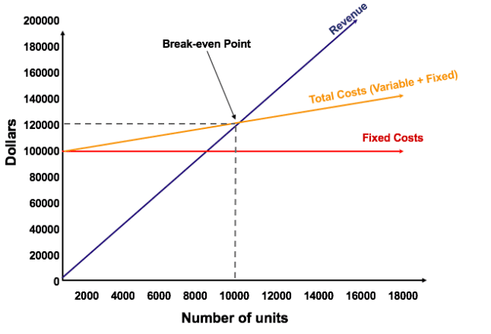

Slide 57
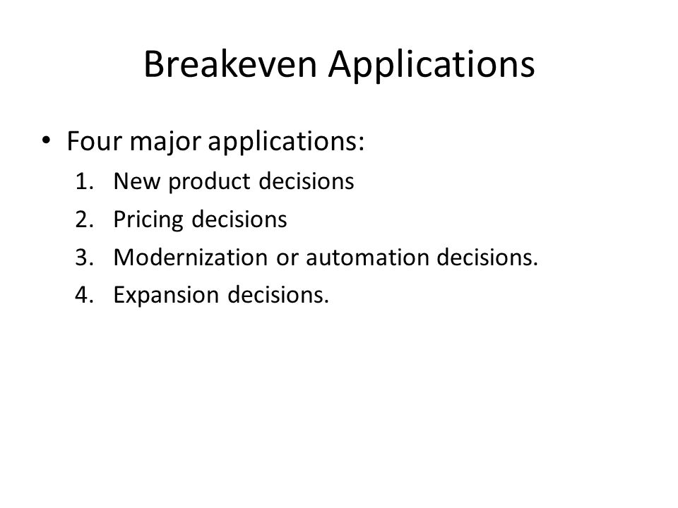
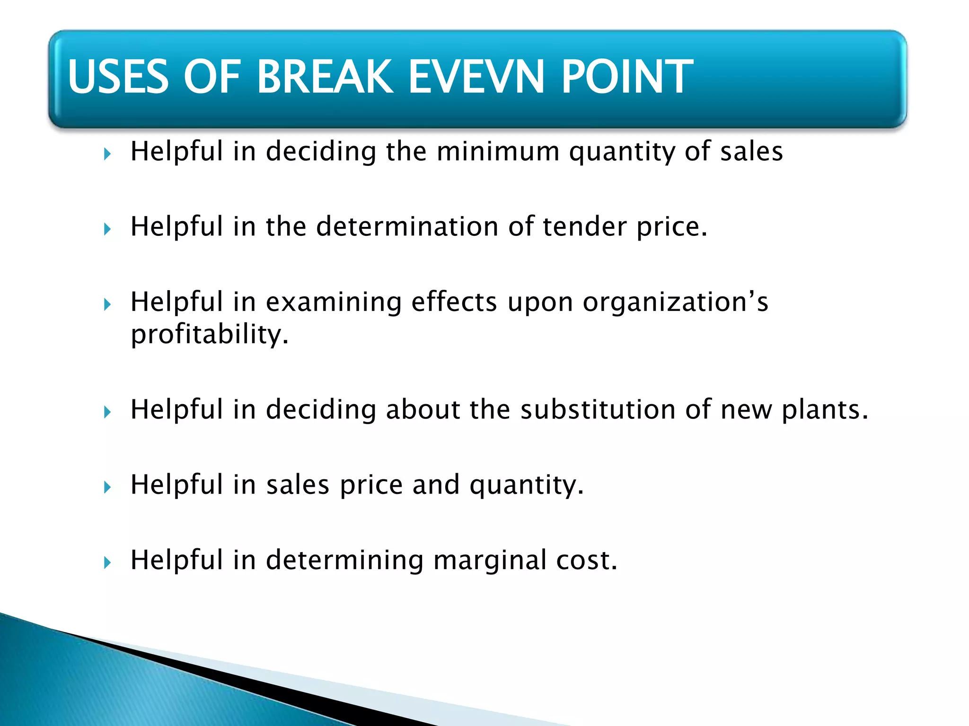

Slide 58
THANK YOU

